Slide 1
Domain ML
Technology: Python
Natural language translation engine for announcements and information dissemination at stations

Slide 2
INDEX
    Abstract
    Objective of project
    Problem Statement
    Scope & Motivation
    Introduction
    Literature survey
    Existing Method
    Disadvantages
    Proposed method
    Advantages
    Project Flow
    Hardware and Software Requirements
    Architecture
    Modules
    UML Diagram
    References

Slide 3
ABSTRACT
This project integrates the Google Text-to-Speech (gTTS) Python library to develop a multilingual information dissemination system for Indian railway stations. gTTS, renowned for its natural-sounding speech and extensive language support, including various Indian dialects, plays a key role in converting text to audible announcements. The system is designed to seamlessly translate written information into speech, enhancing accessibility and convenience for passengers. It incorporates real-time text-to-speech conversion, ensuring dynamic and accurate information delivery. Essential for stations, this solution addresses the need for clear communication in noisy environments and is adaptable for mobile platforms, making it a robust tool for modern, efficient railway operations.
Keywords: gTTS, Multilingual, Indian Railways, Text-to-Speech, Information Dissemination, Real-Time Conversion, Speech Synthesis, Python, Accessibility, Noisy Environments, Mobile Integration.

Slide 4
    OBJECTIVE OF PROJECT
The objective of this project is to develop a sophisticated natural language translation engine utilizing the Google Text-to-Speech (gTTS) Python library, aimed at revolutionizing announcements and information dissemination across Indian railway stations. By facilitating multilingual speech synthesis, the system seeks to enhance passenger experience through real-time, accessible, and clear communication, particularly in noisy environments, thereby improving operational efficiency and inclusivity in India's vast railway network.

Slide 5
    PROBLEM STATEMENT
In Indian railway stations, passengers often face challenges in receiving clear, timely information due to language barriers and noisy environments. The existing systems struggle to cater to the diverse linguistic landscape and dynamic nature of railway operations. This project addresses the need for a versatile, real-time information dissemination system that leverages the gTTS library for natural-sounding, multilingual announcements, enhancing accessibility and passenger experience.

Slide 6
    MOTIVATION
The motivation behind "Natural Language Translation Engine for Announcements and Information Dissemination at Stations" stems from the critical need to enhance passenger experience in Indian railways. By leveraging the gTTS library for multilingual speech synthesis, this project aims to bridge communication gaps in noisy environments, ensuring accessible, dynamic, and accurate information delivery, thus significantly improving efficiency and convenience in railway operations.

Slide 7
SCOPE
The scope of this project encompasses the development of a multilingual text-to-speech system for Indian railway stations, utilizing the gTTS Python library for real-time information conversion into audible announcements. It focuses on enhancing passenger accessibility and convenience by supporting various Indian dialects, ensuring clear communication in noisy settings, and offering mobile platform integration for improved railway operational efficiency.

Slide 8
INTRODUCTION
In the bustling environs of Indian railway stations, where the confluence of diverse languages and dialects presents a unique challenge to effective communication, the need for a robust, multilingual information dissemination system is paramount. This project introduces a cutting-edge solution: a Natural Language Translation Engine for Announcements and Information Dissemination at Stations, leveraging the capabilities of the Google Text-to-Speech (gTTS) Python library. Known for its natural-sounding speech synthesis and extensive support for a wide array of languages, including a multitude of Indian dialects, gTTS stands at the core of this innovative system. Designed to bridge the communication gap, this system adeptly converts textual information into audible announcements, thereby enhancing accessibility and convenience for passengers. Its cornerstone is the real-time text-to-speech conversion feature, which ensures the delivery of dynamic and accurate information, vital for the ever-changing schedules and updates typical of railway operations.

Slide 9
This project is not just about addressing the need for clear communication amidst the cacophony of noisy environments; it's also about inclusivity. By incorporating speech synthesis that accommodates various Indian languages, the system ensures that information is accessible to a broader audience, making travel more seamless and less daunting for passengers from different linguistic backgrounds. Moreover, with its adaptability for mobile platforms, the solution proposed herein transcends traditional announcement systems, offering a versatile tool for modern, efficient railway operations. This initiative not only enhances passenger experience but also sets a new standard for public transportation systems in multilingual and multicultural contexts.

Slide 10
    LITERATURE SURVEY
S.NO | YEAR | AUTHORS | TITLE | OUT COMES
1 | 1951 | Bar-Hillel, Y | The present state of research on mechanical translation. | Moreover, there's a pressing need for high-speed, albeit potentially lower accuracy, scanning of vast printed materials for various purposes. Bar-Hillel suggests that advancements in MT could address these challenges, offering valuable insights into linguistic communication while facilitating efficient translation and scanning processes.
2 | 1960 | Bar-Hillel, Y. | The present status of automatic translation of languages. | Bar-Hillel also mentions the presence of research centers in England and Italy, highlighting the global interest in MT. Overall, the abstract underscores the growing importance and international engagement in the development of automatic language translation systems.

Slide 11
S.NO | YEAR | AUTHORS | TITLE | OUT COMES
3 | 2011 | Birch, A., Osborne, M. | Reordering metrics for MT. | The study demonstrates that the LRscore aligns more closely with human judgments compared to other metrics like BLEU score. Additionally, training translation model parameters with LRscore results in preferred human-readable translations without sacrificing BLEU scores.
4 | 2014 | Denkowski, M., Lavie, A, Lacruz, I., Dyer, C. | Real time adaptive machine translation for post-editing with cdec and TransCenter. | TransCenter enables users to connect to Realtime systems and logs post-editing activity, aiding in the analysis of human translator productivity. The combination of these tools allows for the streamlined deployment of MT systems tailored for post-editing. Additionally, both tools and post-editing data from validation experiments are available under an open-source license.

Slide 12
S.NO | YEAR | AUTHORS | TITLE | OUT COMES
5 | 2018 | Green, S., Wang, S., Chuang, J., Heer, J. Schuster, S., Manning, C. D. | Human effort and machine learnability in computer aided translation. In Proceedings of EMNLP | Evaluation with professional translators reveals that while postediting is faster, interactive translation yields higher quality results after re-tuning the MT system. Direct tuning to Human Translation Error Rate (HTER) results in significant improvements in subsequent machine output, indicating the efficacy of interactive translation methods.
6 | 2019 | Grudin, J. (2012). | A moving target—the evolution of human-computer interaction. In Jacko, J. A. (Ed.), Human-Computer Interaction Handbook: Fundamentals, Evolving Technologies | Through this examination, he likely highlights the challenges and opportunities inherent in navigating this evolving landscape. The chapter promises insights into the past, present, and future of HCI, providing a comprehensive understanding of this interdisciplinary field.

Slide 13
    EXISTING SYSTEM
The existing system for railway information dissemination, relying on older libraries, offers basic multilingual support primarily for major Indian languages. It utilizes traditional text-to-speech (TTS) engines and basic natural language processing (NLP) techniques. The system is capable of scripted station announcements and responses over IVRS, but lacks real-time adaptability and the nuanced understanding of modern NLP tools. Its speech synthesis, while functional, does not match the natural quality of newer technologies like gTTS. Limited by older frameworks, the system faces challenges in noise reduction, dynamic content generation, and integration with contemporary mobile and web platforms, highlighting the need for an upgrade to more advanced solutions.

Slide 14
DISADVANTAGES
1. Limited multilingual support, primarily for major Indian languages, restricts accessibility for diverse linguistic communities.
2. Outdated text-to-speech (TTS) engines result in unnatural sounding announcements, diminishing user experience.
3. Lack of real-time adaptability hinders the system's ability to provide timely and relevant information.
4. Inadequate noise reduction capabilities diminish the clarity of announcements, affecting communication in busy station environments.
5. Integration challenges with modern mobile and web platforms limit the system's accessibility and usability for passengers.

Slide 15
PROPOSED METHOD
The proposed system leverages advanced technologies like the Google Text-to-Speech (gTTS) Python library to revolutionize information dissemination in Indian railway stations. This solution offers extensive multilingual support, including regional Indian languages and potential for foreign language expansion. It integrates real-time text-to-speech conversion with sophisticated natural language processing (NLP) capabilities, facilitating dynamic, accurate, and natural-sounding announcements. Designed to operate effectively in noisy environments, the system includes noise reduction techniques and is optimized for mobile and web platforms, ensuring accessible and efficient communication. This modern approach significantly enhances passenger experience through timely, clear, and personalized information delivery in a variety of languages.

Slide 16
ADVANTAGES
1. Enhanced Accessibility: Provides clear, natural-sounding announcements in multiple languages, including regional Indian dialects, improving inclusivity for diverse passenger demographics.
2. Real-Time Information Delivery: Ensures dynamic and accurate dissemination of information, adapting swiftly to changes and updates in railway operations.
3. Improved Passenger Experience: Delivers personalized and timely announcements, significantly enhancing user satisfaction and convenience during travel.
4. Noise Reduction Capabilities: Maintains clarity of communication in the challenging and noisy environments typical of railway stations.
5. Mobile and Web Optimization: Facilitates easy access to information across various platforms, making the system adaptable and convenient for on-the-go use.

Slide 17
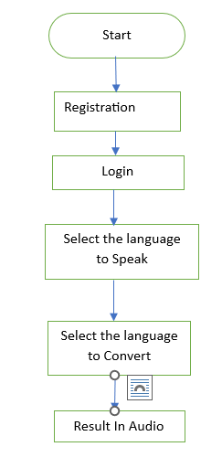
BLOCK DIAGRAM

Slide 18
HARDWARE & SOFTWARE REQUIREMENTS
SOFTWARE REQUIREMENS
Operating System : Windows 7/8/10
Server side Script : HTML, CSS, Bootstrap & JS
Programming Language : Python
Libraries : Flask, Pandas, Mysql.connector, Os, Smtplib, Numpy
IDE/Workbench : PyCharm, VS-Code
Technology : Python 3.6+
Server Deployment : Xampp Server
Database : MySQL

Slide 19
HARDWARE & SOFTWARE REQUIREMENTS
HARDWARE REQUIREMENTS
Processor - I5/Intel Processor
RAM - 8GB (min)
Hard Disk - 160 GB
Key Board - Standard Windows Keyboard
Mouse - Two or Three Button Mouse
Monitor - Any

Slide 20
FUNCTIONAL AND NON-FUNCTIONAL REQUIREMENTS
Requirement’s analysis is very critical process that enables the success of a system or software project to be assessed. Requirements are generally split into two types: Functional and non-functional requirements.
Functional Requirements: These are the requirements that the end user specifically demands as basic facilities that the system should offer. All these functionalities need to be necessarily incorporated into the system as a part of the contract. These are represented or stated in the form of input to be given to the system, the operation performed and the output expected. They are basically the requirements stated by the user which one can see directly in the final product, unlike the non-functional requirements.

Slide 21
FUNCTIONAL AND NON-FUNCTIONAL REQUIREMENTS
Examples of functional requirements:
Authentication of user whenever he/she logs into the system
System shutdown in case of a cyber-attack
A verification email is sent to user whenever he/she register for the first time on some software system.
Non-functional requirements: These are basically the quality constraints that the system must satisfy according to the project contract. The priority or extent to which these factors are implemented varies from one project to other. They are also called non-behavioral requirements.

Slide 22
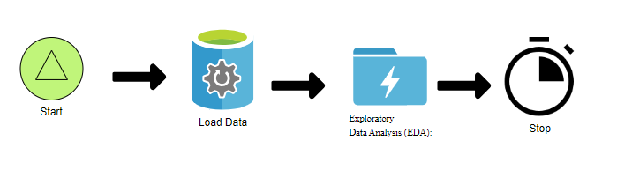
ARCHITECTURE

Slide 23
Use Case Diagram:
1) A use case diagram in the Unified Modeling Language (UML) is a type of behavioral diagram defined by and created from a Use-case analysis.
2) Its purpose is to present a graphical overview of the functionality provided by a system in terms of actors, their goals (represented as use cases), and any dependencies between those use cases.
3) The main purpose of a use case diagram is to show what system functions are performed for which actor. Roles of the actors in the system can be depicted.

Slide 24
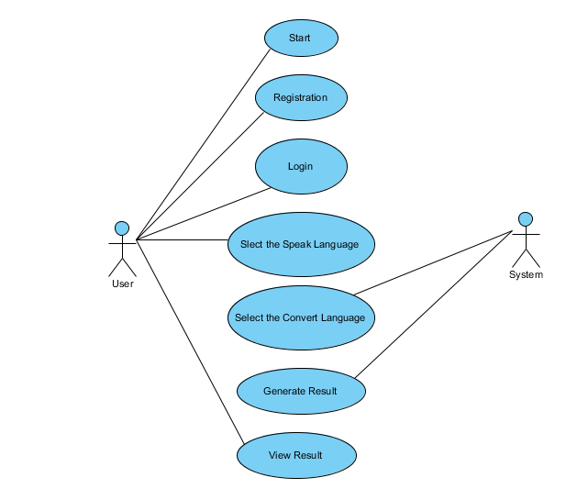
    UML DIAGRAMS
Figure: Use Case Diagram

Slide 25
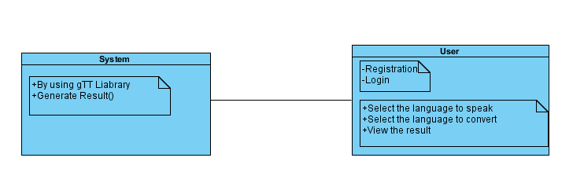
Class Diagram:
In software engineering, a class diagram in the Unified Modeling Language (UML) is a type of static structure diagram that describes the structure of a system by showing the system's classes, their attributes, operations (or methods), and the relationships among the classes. It explains which class contains information

Slide 26
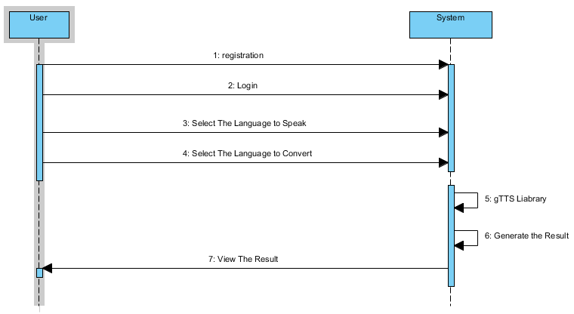
Sequence Diagram:
A sequence diagram in Unified Modeling Language (UML) is a kind of interaction diagram that shows how processes operate with one another and in what order.
It is a construct of a Message Sequence Chart. Sequence diagrams are sometimes called event diagrams, event scenarios, and timing diagrams
Figure: Sequence diagram

Slide 27
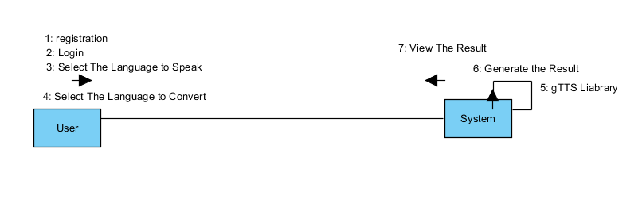
Collaboration Diagram:
In collaboration diagram the method call sequence is indicated by some numbering technique as shown below. The number indicates how the methods are called one after another. We have taken the same order management system to describe the collaboration diagram. The method calls are similar to that of a sequence diagram. But the difference is that the sequence diagram does not describe the object organization whereas the collaboration diagram shows the object organization.
Figure: Collaboration diagram

Slide 28

Deployment Diagram
Deployment diagram represents the deployment view of a system. It is related to the component diagram. Because the components are deployed using the deployment diagrams. A deployment diagram consists of nodes. Nodes are nothing but physical hardware’s used to deploy the application.
Figure: Deployment diagram

Slide 29
Activity Diagram:
Activity diagrams are graphical representations of workflows of stepwise activities and actions with support for choice, iteration and concurrency. In the Unified Modelling Language, activity diagrams can be used to describe the business and operational step-by-step workflows of components in a system. An activity diagram shows the overall flow of control.

Slide 30
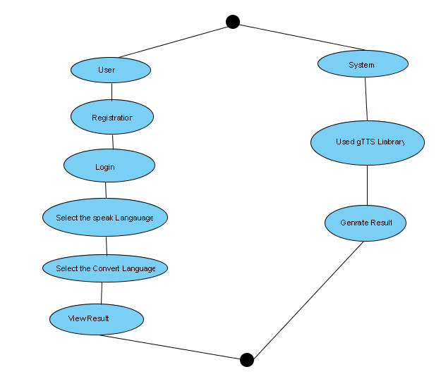
Figure: Activity diagram

Slide 31
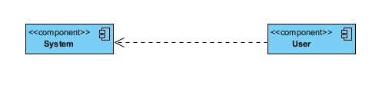
Component Diagram:
A component diagram, also known as a UML component diagram, describes the organization and wiring of the physical components in a system. Component diagrams are often drawn to help model implementation details and double-check that every aspect of the system's required function is covered by planned development.
Figure: Component diagram

Slide 32
    UML DIAGRAMS
ER Diagram:
An Entity–relationship model (ER model) describes the structure of a database with the help of a diagram, which is known as Entity Relationship Diagram (ER Diagram). An ER model is a design or blueprint of a database that can later be implemented as a database. The main components of E-R model are: entity set and relationship set.
An ER diagram shows the relationship among entity sets. An entity set is a group of similar entities and these entities can have attributes. In terms of DBMS, an entity is a table or attribute of a table in database, so by showing relationship among tables and their attributes, ER diagram shows the complete logical structure of a database. Let’s have a look at a simple ER diagram to understand this concept.

Slide 33
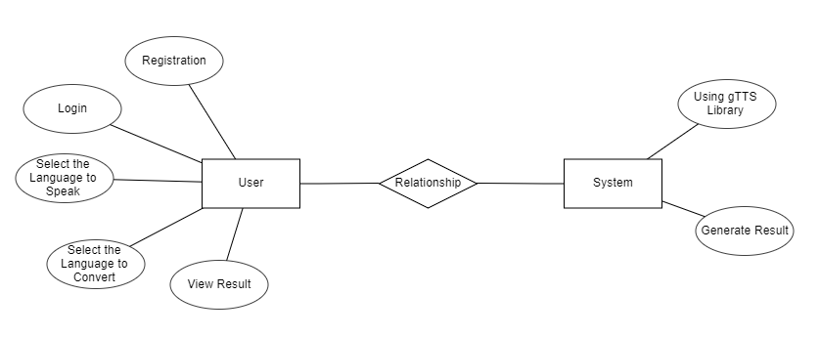
Figure: ER diagram

Slide 34
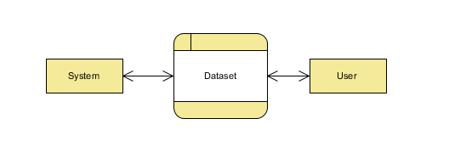
DFD Diagram:
A Data Flow Diagram (DFD) is a traditional way to visualize the information flows within a system. A neat and clear DFD can depict a good amount of the system requirements graphically. It can be manual, automated, or a combination of both. It shows how information enters and leaves the system, what changes the information and where information is stored. The purpose of a DFD is to show the scope and boundaries of a system as a whole. It may be used as a communications tool between a systems analyst and any person who plays a part in the system that acts as the starting point for redesigning a system.
Figure: Context Level diagram

Slide 35
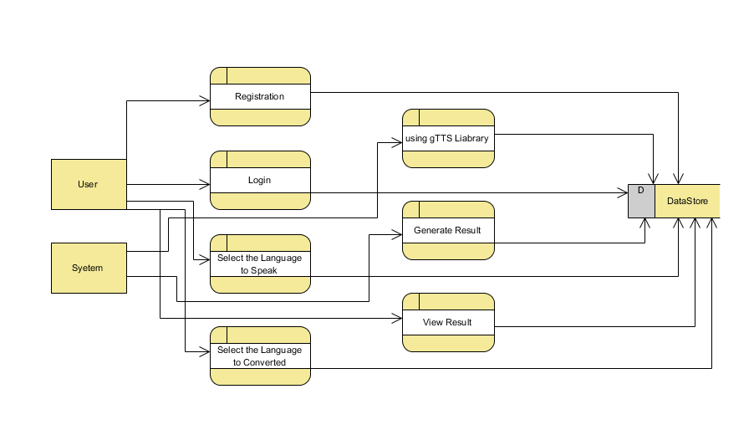
FigureLevel-1 diagram

Slide 36
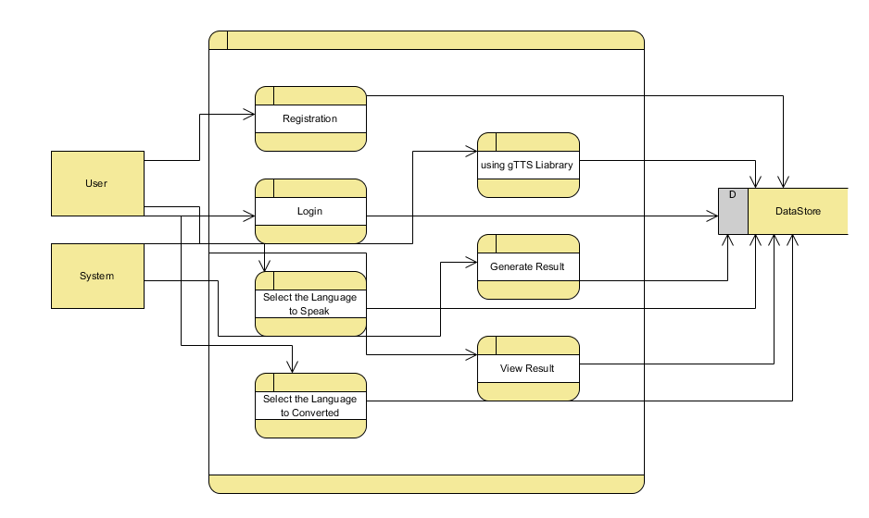
Figure:Level-2 diagram

Slide 37
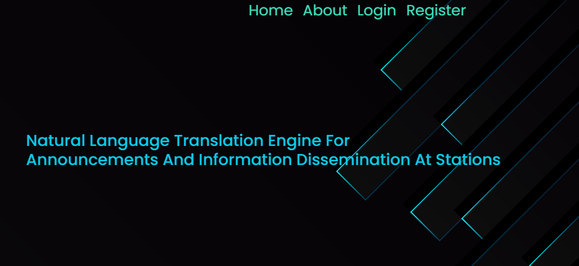
OUTPUT SCREEN SHOTS WITH DESCRIPTION.
Home Page: Home page of the project

Slide 38
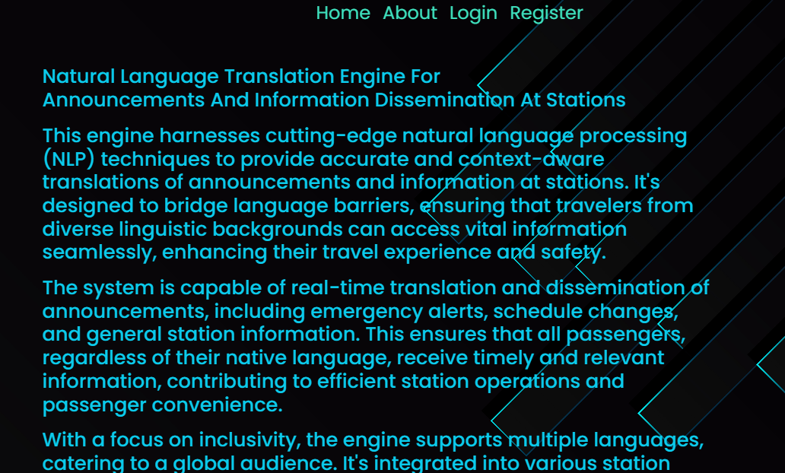
About Page: About page of the project

Slide 39
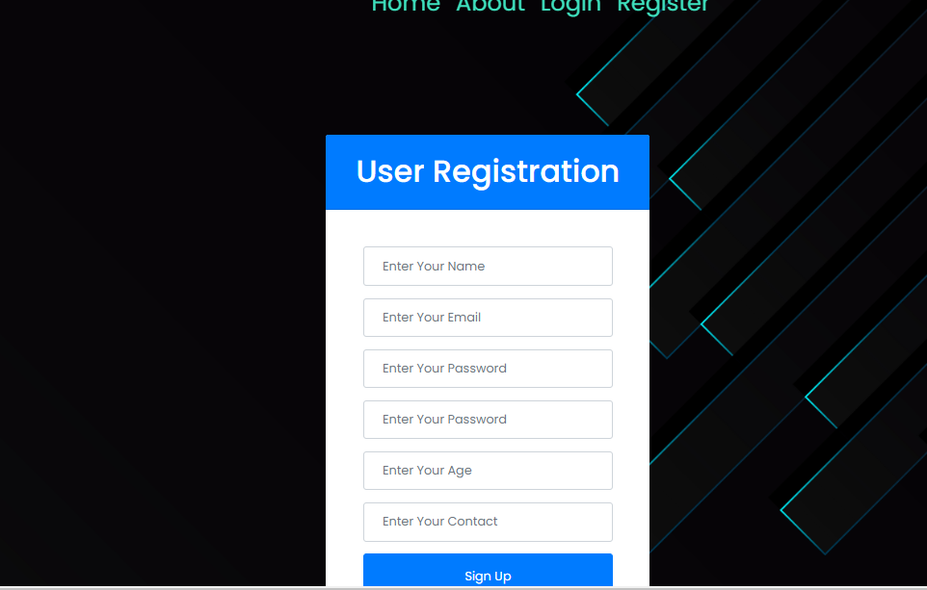
Register Page: User need register with his/her credentials.

Slide 40
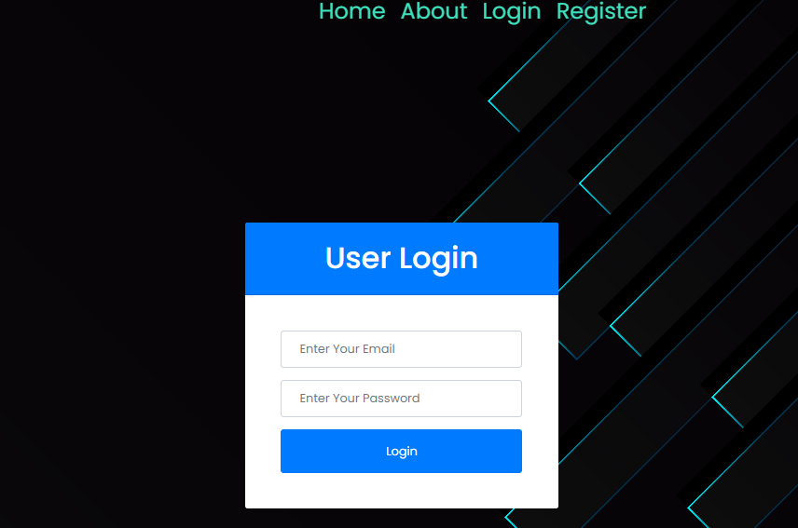
User Login: User can login with valid credentials.

Slide 41
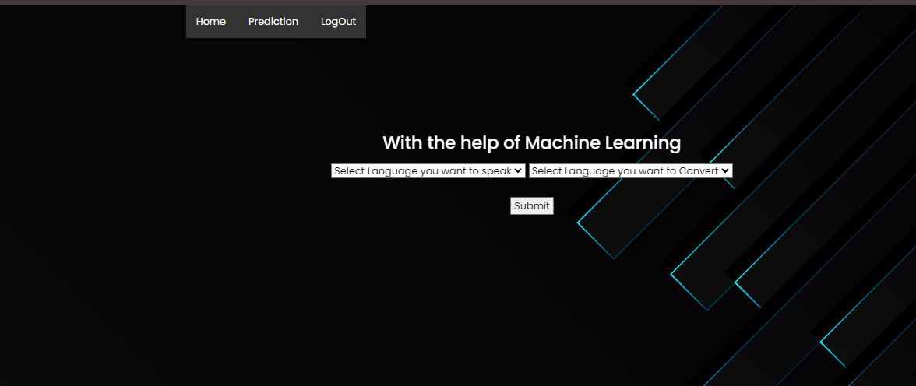
Prediction: User can give a input and view The Predicted Result.

Slide 42
MODULES
1. User:
1.1 Input Model:
The user must provide input values for the certain fields in order to get results.
1.2 View Results:
User view’s the generated results from the model.
2. System
2.1 Pre-processing:
Data need to be pre-processed according the gTTS Liabrary.
2.2 Generated Score:
Here generate the result

Slide 43
CONCLUSION
In conclusion, the integration of the Google Text-to-Speech (gTTS) Python library offers a powerful solution for enhancing communication at Indian railway stations. By converting written information into audible announcements across multiple languages and dialects, this system significantly improves accessibility and convenience for passengers. Its real-time text-to-speech conversion capability ensures dynamic and accurate information delivery, addressing the challenges of noisy environments typical in station settings. Moreover, its adaptability for mobile platforms underscores its relevance in modern railway operations. Overall, this project presents a robust tool for efficient information dissemination, aligning with the evolving needs of the Indian Railways and fostering a more inclusive travel experience.
In conclusion, the analysis and prediction of crime hotspots using machine learning with a stacked generalization approach represent a significant advancement in law enforcement strategies. This innovative approach harnesses the power of diverse machine learning models to provide a comprehensive understanding of crime patterns. By employing stacked generalization, the system combines the strengths of multiple algorithms, enhancing predictive accuracy and reliability. The findings empower law enforcement agencies with actionable insights into crime-prone areas, enabling proactive measures for crime prevention and resource allocation. This research contributes to the evolving landscape of predictive policing, fostering a safer environment through the synergy of data-driven insights and advanced machine learning techniques in crime hotspot analysis.

Slide 44
FUTURE ENHACEMENT
Future enhancements for the natural language translation engine could include integrating machine learning algorithms to improve translation accuracy and adaptability to regional dialects. Additionally, implementing voice recognition technology would enable interactive features, allowing passengers to ask questions and receive spoken responses in their preferred language. Integration with real-time data feeds could also provide up-to-date information on train schedules, delays, and platform changes, enhancing the system's utility and reliability. Furthermore, incorporating sentiment analysis could help tailor announcements to better meet passengers' needs and preferences, fostering a more personalized and user-friendly experience at railway stations.

Slide 45
REFERENCES
1. Bar-Hillel, Y. (1951). The present state of research on mechanical translation. American Documentation 2 (4): 229-237.
2. Bar-Hillel, Y. (1960). The present status of automatic translation of languages. Advances in Computers 1: 91-163.
3. Beyer, R. T. (1965). Hurdling the language barrier. Physics Today 18 (1): 46-52.
4. Birch, A., Osborne, M. (2011). Reordering metrics for MT.
5. Bisbey, R., Kay, M. (1972). The MIND translation system: a study in man-machine collaboration. Technical Report P-4786, Rand Corp.
6. Carbonell, J. (1970). AI in CAI: An artificial-intelligence approach to computer-assisted instruction. IEEE Transactions on Man-Machine Systems 11 (4): 190-202.
7. Card, S. K., Moran, T. P., Newell, A. (1983). The Psychology of Human-Computer Interaction. Lawrence Erlbaum Associates.

Slide 46
8. Church, K. W., Hovy, E. (1993). Good applications for crummy machine translation. Machine Translation 8: 239-258.
9. Debons, A., Cameron, W. J. (Eds.) (1975). Perspectives in Information Science, Volume 10 of the NATO Advanced Study Institutes Series. Springer.
10. Denkowski, M., Lavie, A, Lacruz, I., Dyer, C. (2014). Real time adaptive machine translation for post-editing with cdec and TransCenter. In Proceedings of the EACL 2014 Workshop on Humans and Computer-assisted Translation.
11. Engelbart, D. C. (1962). Augmenting human intellect: A conceptual framework. Technical report, SRI Summary Report AFOSR-3223.
12. Foster, G., Langlais, P., Lapalme, G. (2002). TransType: text prediction for translators. In Proceedings of ACL Demonstrations, 93-94.
13. Green, S., Wang, S., Chuang, J., Heer, J. Schuster, S., Manning, C. D. (2014). Human effort and machine learnability in computer aided translation. In Proceedings of EMNLP, 1225-1236.
14. Grudin, J. (2009). AI and HCI: Two fields divided by a common focus. AI Magazine 30 (4), 48-57.

